Slide 1


INTERNSHIP REPORT PRESENTATION
P
Grow lant
Web Development Internship at Raj Multimedia Education
GrowPlant Provides expert planting, care, research and sales for healthy trees and plants to create greener, sustainable places.
Personal Details.
  Intern Name : Jenish Bhalani
  Roll No. : 13
  Mentor Name : Bajarang sir
  Company Name : Raj Multimedia Education

Slide 2
Internship Info.
Name of Institute : Raj Multimedia Education
Duration: 120 Hours
Domain: Web Development & Graphics Designing
Department: Ui & Ux
Objective: To gain practical experience and industry exposure

Slide 3
ABOUT THE COMPANY — Raj Multimedia Education
Raj Multimedia Education is a multimedia training institute that provides IT and digital skills training.
The institute offers courses such as web design, graphic design, video editing, UI/UX, and digital marketing.
The company’s mission is to provide students with practical knowledge and
career opportunities.
Along with training, job assistance and recognized certification are also provided.

Slide 4
WORK DONE DURING INTERNSHIP
Designed social media posts using Canva
Created and edited designs of slides using Adobe Photoshop
Developed and managed a mini website using WordPress
Designed a personal portfolio using Figma

Slide 5
1. Canva
Graphic Designing Internship Work – GrowPlant
During my Graphic Designing internship, I worked on Canva to create visual content for GrowPlant, a company focused on growing, caring, researching, and selling plants.
My work included designing :
  company logo
  branding poster
  marketing poster
  business card
  Flyer
  banner
All designs followed a nature-inspired theme using green color palettes, plant elements, and clean typography to reflect sustainability and growth. These creatives were developed for brand identity building, product promotion, and customer engagement, while maintaining consistency across digital and print platforms.
This internship helped me enhance my creative skills, branding knowledge, and practical experience in graphic design using Canva.

Slide 6




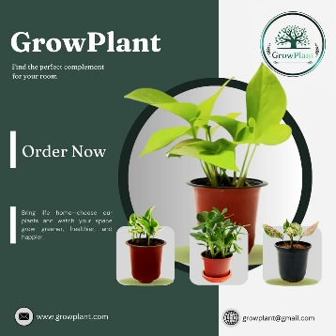

Work Done in Canva
Logo
Banner
Business Card
Flyer
Marketing Poster
Branding Poster

Slide 7
2. Adobe Photoshop
Graphic Designing Internship Work – GrowPlant
During my Graphic Designing internship, I worked on Adobe Photoshop to design promotional and marketing visuals for GrowPlant, a company focused on growing, caring, researching, and selling plants.
My work included designing :
sliders (3 designs)
Youtube thumbnail (1 design)
The sliders were created to highlight brand awareness, plant care tips, research activities, and product promotion, using high-quality images, clean layouts, and balanced compositions.
Each design followed a nature-inspired green color palette, consistent typography, and visual hierarchy to ensure clarity, engagement, and brand consistency across digital platforms.
This work helped me strengthen my skills in image editing, layer management, typography, color correction, and visual storytelling using Adobe Photoshop.

Slide 8
Work Done in Photoshop
Logo
Banner
Business Card
Flyer
Marketing Poster
Branding Poster

